Slide 1
Java SE 17 – Presentation
Migration from Java SE 8 to Java SE 17

Slide 2
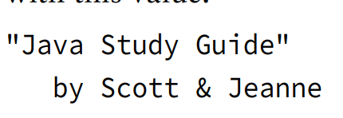
New things
I. Text Block
- We've seen simple ... such as (code illustration snippet 1). However, how can we able to create .... like this:
- We have studied ..., therefore ... (code illustration snippet 2)
- This is a ... string that ... multiple ...
– We can use escape character to create this string, however ...
– Therefore, a feature ... JDK 13 ... called ...

Slide 3
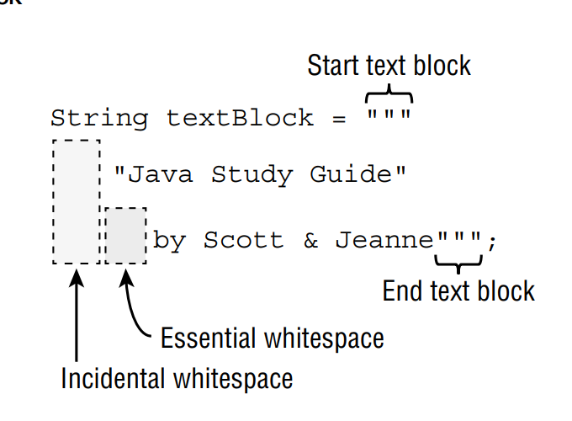
New things
- Text block is started at ... and ended at ...
- ... is the ... on the left ...
- ... is the ... on the right ...
- NOTE: When using text block, we must always ... or else we will get compilation ...
– NOTE 2: In IntelliJ, we can see ... (code illustration snippet 3)

Slide 4
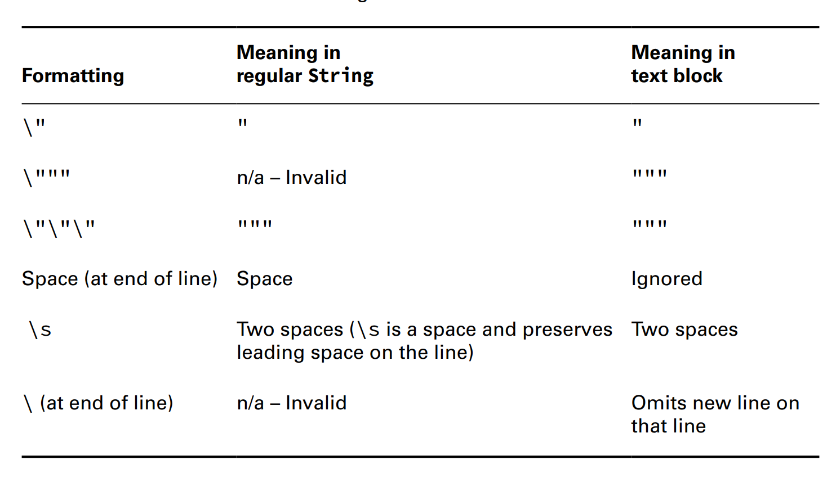


New things
(code illustration snippet 4)
- We can also use ... character in text block
- For "\", we have ... cases with ....

Slide 5
New things
(code illustration snippet 5,6,7,8)

Slide 6
New things
II – Inferring the Type with "var"
- We have been using ... for variable .... But in Java ... (originally Java ...), has introduced a feature called "variable ...". However, to ... feature, certain ... must be ...
(code illustration snippet 9)
- The full name for this feature is called "... variable ..." They called it ... variable because this feature can only be used with ... variable
(code illustration snippet 10)
- We have understood the ... part, then what does ... mean ? When we ... variable using ..., we are instructing ... to ... the type of .... ... will then based on ... and make inferrence about ...
(code illustration snippet 11)
- Differ from traditional ..., local variable type ... allows ... lines ... (code illustration snippet 12)
(code illustration snippet 13)
- The following code didn't compile because both ... and ... use ... but they aren't .... => ... Java type ... => ...
– Although we can see there was a ... branch, however, this wasn't at the same ... as ... => ...
- local variable ... doesn't ... multiple ... (code illustration snippet 13)
(code illustration snippet 14)

Slide 7
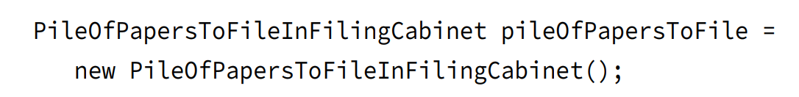
New things
- The illustrated code didnt compile because ... compond .... doesn't allow ...
- The second line got error because ....
- ... can be any ..., Java doesn't know ..., they could just ..., however, it will... => Java ... decided ...
– However, the second line is ... if and only if ... variable ... with a ...
(code illustration snippet 15)
- The illustrated code got error because ... can't be used with ...
- .... keyword isn't a "... word" but rather a "... type" => ... won't be able to used to ... types such as ...
(code illustration snippet 16)
- When do we actually using "var" ? When we have situation like this:
- The name is ... => we use "var" to ... =>

Slide 8
New things
III – instanceof operator (not a new thing but we never learned this in OCA SE 8)
- Another type of operator we have to learn is ...
– Its job is to ... (code illustration snippet 17)
- We can see that there are ... but ... => This is object ... => if we use ..., the value will be ...
– There are some cases where ... polymorphism ... (e.g: create a ... that recieve ...)
(code illustration snippet 18)
- We can also see that in the method, we ... "time" from ... to ....
- This is .... when using .... with objects that ...
- Generally, we "should" ... before ...
- NOTE: For the exam, we will only be asked about .... with ... or ...., although ... can be used with other ... such as ...
Invalid "instanceof"
- When using instanceof with ...., we will get ...
null and the instanceof operator
- When we use ... with ... => we will always get ...
– Even if we ... in a ... => We will still get ...
– But if we try ... => We get a ...

Slide 9
New things
IV – Shortening code with Pattern Matching
- In Java ..., a new ... has been developed called "Pattern Maching". This ... uses ... statement and ....
- Pattern matching is a ... used in ... that allows ... runs under certain ...
(pattern matching # ...)
- ... is borned to reduce ... code (... code is a type of code that ... multiple...). Later version ... trying to .... code
(code illustration snippet 19)
- As you can see in the method, we always ... => ...
- We have to do ... because the method ... is only ...
– This type of code appears ... that Java ... has to ...
(code illustration snippet 20)
- If the ... is ... => we cast ... and ... => We can use ...
– The ... "data" is called ... This new type of code even removes ... because cast can only be done when ...
- Reassigning ... is often considered ... because we can't ....
(code illustration snippet 21)
- We can ... this ... by ... (code illustration snippet 22)

Slide 10
New things
Pattern variables and Expressions
- Pattern matching also allows us to ... to ... data
(code illustration snippet 23)
- A condition to use ... is .... It can't be a ..., a ..., and a ...
– Although normal ...
(code illustration snippet 24)
Flow scoping
- ... has something called flow scoping. Flow scoping is used to ... variable.
- Unlike traditional ..., the ... variable ... based on ...
(code illustration snippet 25)
- In illustrated example, we use ... instead of ... which ... => The ... will run ... => ...
(code illustration snippet 26, 27)
- According to Java ... a variable ... in ... cases
+) The condition ...
+) The condition ... and ... completed ... (all of the statements such as ... counted as ...)
=> These are ... variable ...

Slide 11
New things
(code illustration snippet 28,29)
- The scope of ... is defined ... (note 1)
V – New swtich statement feature and Switch Expression
- In Java 14 of ..., allowed to ....
(code illustration snippet 30)
(code illustration snippet 31)
- We can see that this method is .... => in Java ..., a new type of ... called ....
- It has ... syntax than ...
– We use it as a ... and assign .... (of course the type ...)
(code illustration snippet 32)
- Of course we can use ... normal ..., and we can ... combine ... (code illustration snippet 33)
- Rules when using ...
+)
+)
+)
- However, if switch isn't ... then ... needed
Notes:
NOTE 1: https://docs.oracle.com/javase/specs/jls/se17/html/jls-6.html#jls-6.3.2:~:text=a%20when%20false.-,6.3.2.%C2%A0Scope%20for%20Pattern%20Variables%20in%20Statements,-Only%20a%20few

Slide 12
New things
- For ... expression, ... is needed because it doesn't differ from ... => a ... is needed at the ....
– In new ..., if we don't use ... => we must have ...
- Otherwise, we don't need ...
(code illustration snippet 32, again
VI – New String class methods
strip()
stripLeading() and stripTrailing()
- NOTE: strip() and trim() .... but strip()...
working with indentation
- We have 2 new methods for ...
indent(int numberSpaces)
- If we add a ... number => ...
– If we add a ... number => If ... than the total ... =>
- But if the number ... than the total => ...
- If we add 0 => ...
Notes:
NOTE 1: https://docs.oracle.com/javase/specs/jls/se17/html/jls-6.html#jls-6.3.2:~:text=a%20when%20false.-,6.3.2.%C2%A0Scope%20for%20Pattern%20Variables%20in%20Statements,-Only%20a%20few

Slide 13
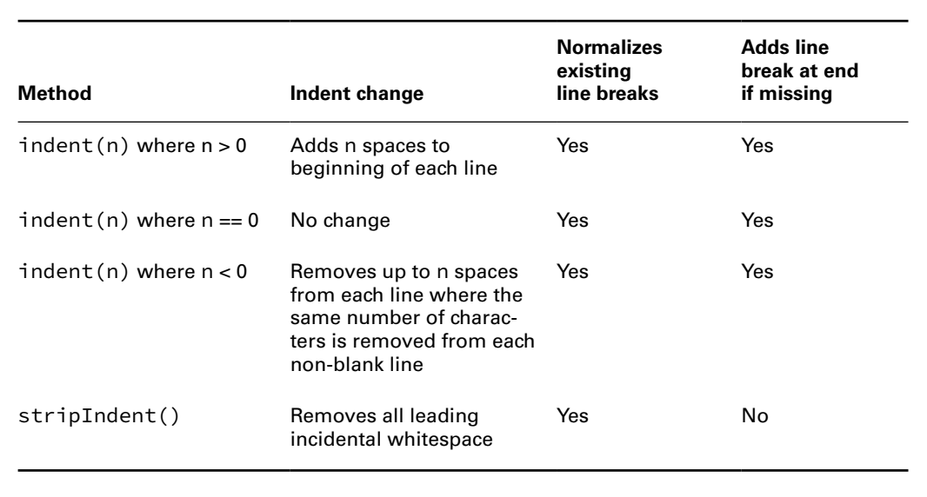


New things
- Indent also add a ... if .... This is because if we add a ... before the line ... => ... won't ... => We must add a ... to move ... line
(code illustration snippet 34)
- However, when we use ... with .... String ... there will be ... cases:
+)... (code illustration snippet 35)
+)...(code illustration snippet 36)
(the book explains stripIndent() in a pretty stupid way, so I will explain it in my way) - stripIndent() is usually used with ... String, but use ... to represent ... => The ... line and ... space will ... => This method will ...
(code illustration snippet 37)
Notes:
NOTE 1: https://docs.oracle.com/javase/specs/jls/se17/html/jls-6.html#jls-6.3.2:~:text=a%20when%20false.-,6.3.2.%C2%A0Scope%20for%20Pattern%20Variables%20in%20Statements,-Only%20a%20few

Slide 14
New things
- In ... String, if we add a "\" ... => ....
- To transform ...., we use translateEscape()
(code illustration snippet 38)
formatted()
(code illustration snippet 39)
NOTE: %f ....
– If we try to pass ... => exception ...
(code illustration snippet 40)
- format() also support something called ...
- We have seen some example about "%f". For standard, %f will ...., but we can ... this ... by applying ... (Be careful, Java will ... the number if we using this...)
(code illustration snippet 41)
- We can also ... length of ... by using ...
(code illustration snippet 42)
Notes:
NOTE 1: https://docs.oracle.com/javase/specs/jls/se17/html/jls-6.html#jls-6.3.2:~:text=a%20when%20false.-,6.3.2.%C2%A0Scope%20for%20Pattern%20Variables%20in%20Statements,-Only%20a%20few

Slide 15
New things
- If we try to specify ... length ... than ... => Whole ... and the decimal ... depend...
(code illustration snippet 43)
- Also, if we try to specify .... length ... than => Space ...
(we can add 0 ...)
(code illustration snippet 44)
Notes:
NOTE 1: https://docs.oracle.com/javase/specs/jls/se17/html/jls-6.html#jls-6.3.2:~:text=a%20when%20false.-,6.3.2.%C2%A0Scope%20for%20Pattern%20Variables%20in%20Statements,-Only%20a%20few

Slide 16
New things
VII – New java.util.Arrays methods
compare()
– This method is used to ...
- This method returns ... values
+)
+)
+)
(code illustration snippet 45)
-) Some rules when using this method
+)
+)
+)
+)
+)

Slide 17
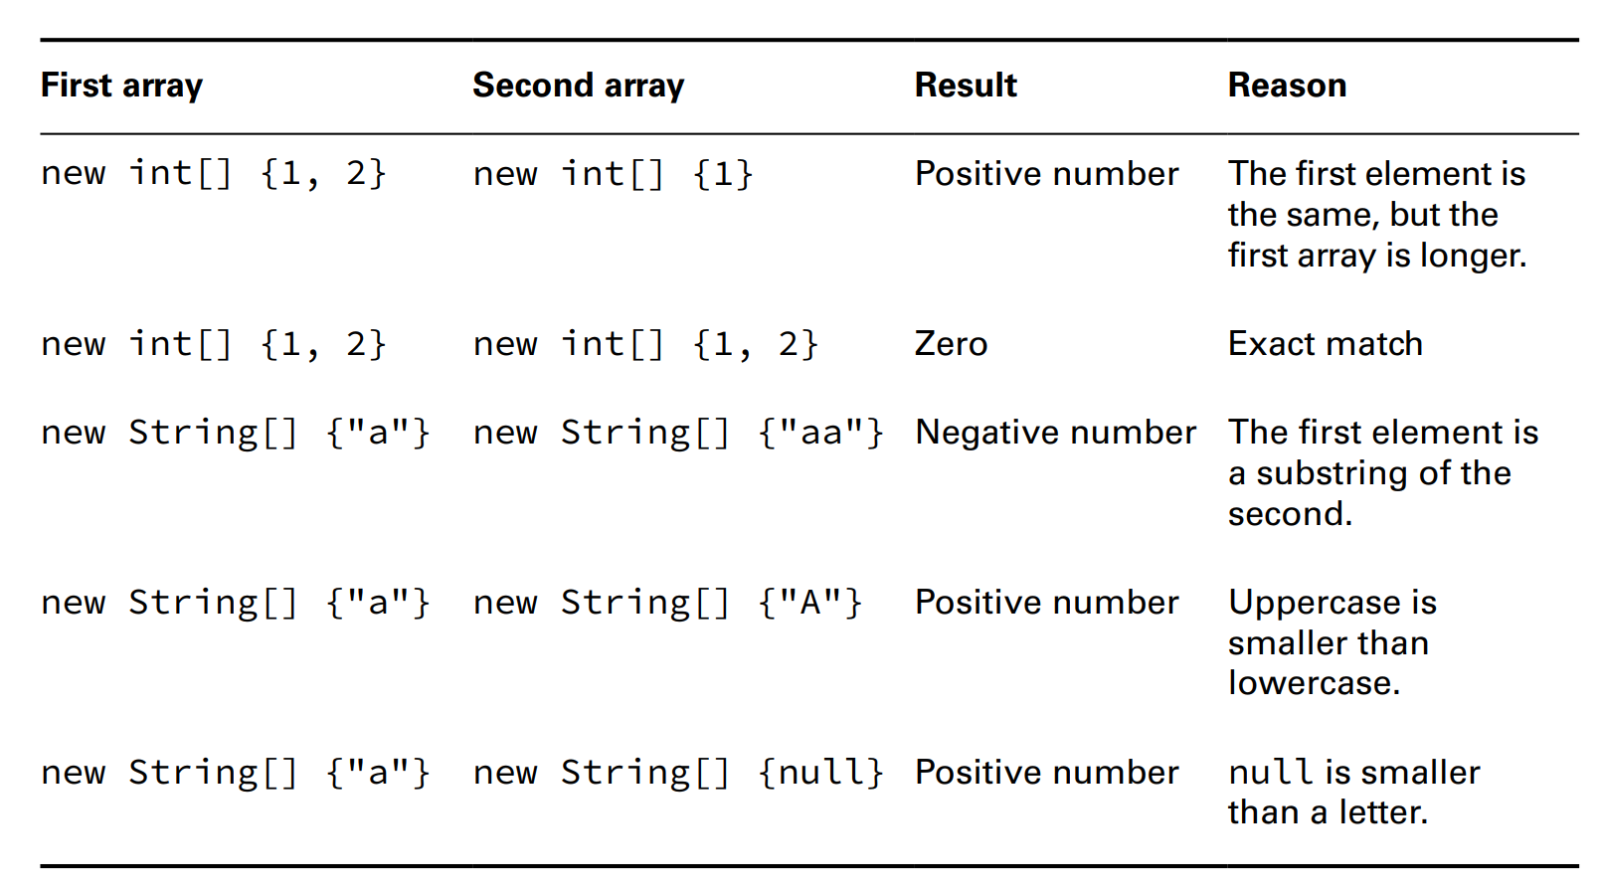

New things
- Here are some other rules for ... and ...
+)
+)
+)
+)
+)

Slide 18
New things
(code illustration snippet 46)
mismatch()
- This method will return if ..., otherwise, ... returned ...
(code illustration snippet 47)

Slide 19
New things
(code illustration snippet 46)
mismatch()
- This method will return if ..., otherwise, ... returned ...
(code illustration snippet 47)
VIII – Date time API
ZonedDateTime
(code illustration snippet 48)
- You can see that there is a ... part in the output, that is called ...
- This is used to calculate .... You can calculate ... by using ...
(NOTE: There is no difference ... and ....)
(code illustration snippet 49)

Slide 20
New things
- Month starts at ... not ...
- To create a ZonedDateTime, you must first ... Then we can able to ...
– Java recommend to use ... or ... instead of pure ... because it may looks ...
– Note: Why don't Java convert ... Because this declaration means ... not ...
(code illustration snippet 50)
- Please note that for ZonedDateTime, we can't use ... to create ...
- We can see that we can't use ... to create ... => This is called ... pattern where the ... object ... to ... method...
- If we try to use ... => ...
(code illustration snippet 51)
- Also if we try to use invalid ... => ...
(code illustration snippet 52)
- When manipulating ..., we can use method ...
(code illustration snippet 53)

Slide 21
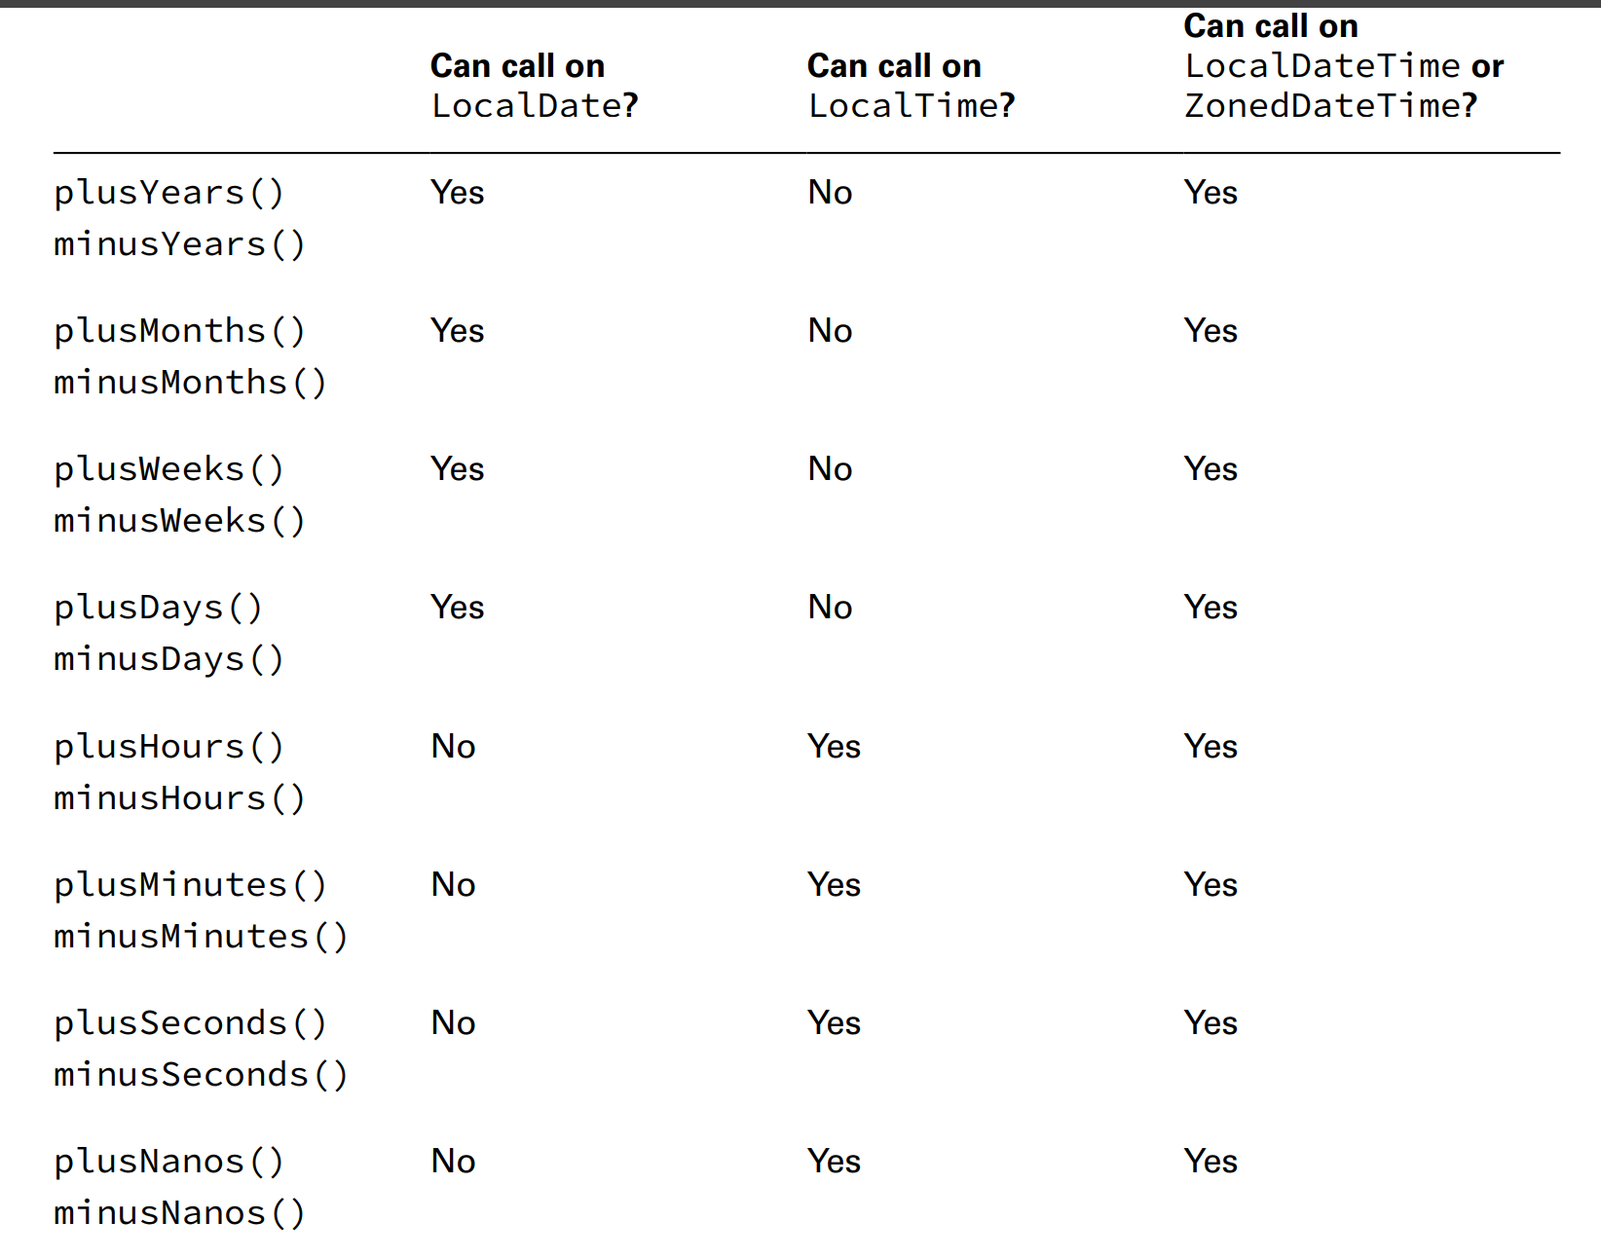
New things
(code illustration snippet 54)

Slide 22
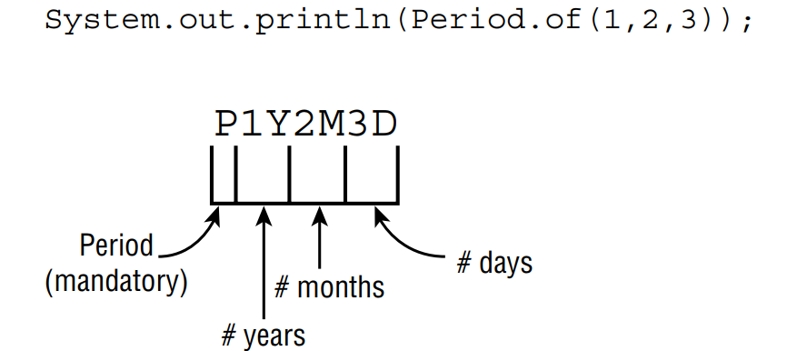
New things
(code illustration snippet 55)
- The problem with the code is that ...
- In order to change ..., we use something called ...
- Period represents ...
(code illustration snippet 56)
- We can use ... and ... on Period
(code illustration snippet 57)
- Period use ... method => we cant use method ... => If we try to use then Java will ... method
(code illustration snippet 58, 59)
The picture below is ...

Slide 23
New things
- All parts that are ... will be ... (code illustration snippet 60)
- As usual, Period can only be used ...
(code illustration snippet 61)
Working with Duration
- We also have Duration, ... than ....
– Of course we can represent 1 ... by passing ..., however, that isn't ... since we have ... to handle ...
(code illustration snippet 62)
- Note that Duration doesn't have method ..., so we can only use ... (e.g: if we want 1h30m,....)
- Duration has ... method that recieve 2 parameters ... 1 is ... and 1 is ... interface (represent ...)
- Currently there is only ... interface (caled ...)
(code illustration snippet 63)
- ChronoUnit also have some useful ... (1/2 ....)

Slide 24
New things
ChronoUnit for difference
- ChronoUnit is also useful for ... between ...
(code illustration snippet 64)
- ChronoaUnit also has a method called ..., used to truncate ... all time that ... than passed ... to ...
- E.g: If I pass hour then ...
- The maximum of ... is ... (which mean that hours ...)
- This method is only applicable to ... (If I use on ... then ... )
(code illustration snippet 65)
Period VS Duration
- Although I can represent a day ... they are still
(code illustration snippet 66)

Slide 25
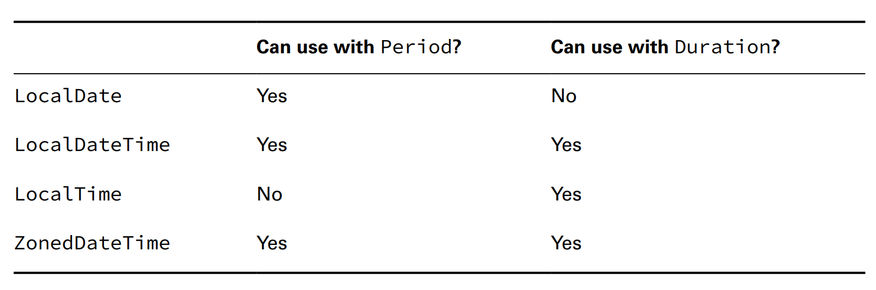
New things

Slide 26
New things
Working with Instant
- Instant represents ... in time
(code illustration snippet 67)
- We can calculate ... between ...
(code illustration snippet 68)
- We can convert a ... to ...
(code illustration snippet 69)
- Note: We can't convert ... to Instant because ... represent many ... since we have many .... Instant is different because there is only 1 ...
Accounting for daylight saving time (the book explain this pretty stupid so I have to search on gg)
- Basically, we have a special ... called Daylight saving time (việt nam gọi là giờ mùa hè).
– In exam, we will study about ... The rule is: On <month> ... the clock will ... (therefore the offset will...)and On <month>, the clock will be ... (therefore the offset will be ...)
(code illustration snippet 70, 71)
(NOTE: ... time zone ? ... time zone)

Slide 27
New things
- Some new things in method
Exception list
- The throws clause can ... multiple ...
(code illustration snippet 72, 73)
Effectively final variable and method parameter
- A variable can be considered as ... if it is not ... after ...
(code illustration snippet 74)
- During OCA, we have asked a question: "Can we consider a function .... as a ....", we can now answer that question
- The book said that function ... is local ... that has been ...(although techincally it is ...)
- JLS specifies that the value ... will be used for .... when the method ... before ...
- JLS also specifies that parameter is definitely ... and not definitely ...
+) definitely ... is ...
+) definitely ... is ...
=> Parameter must be ... before and can be ... because of ...

Slide 28
New things
- Go back to "effectively final", ... can also be ... if they .... above
- This is important because when we study about ... and ... we can understand that local .... and ... expression within ... body can only be able to ... variable that is ...
some new instance variable keywords
transient
volatile
Working with vararg
- Some rules when creating method with vararg
+)
+)
(code illustration snippet 75)
- When calling ... we can either use whole ... or .... (code illustration snippet 76)

Slide 29
New things
- Overall, vararg is ... => we can use all operations ...
(code illustration snippet 77)
(code illustration snippet 78)
If we try to pass ... => ...
(code illustration snippet 79)
Revise weird case about "protected" access modifier
-) For protected ..., we have ... cases
+)
+) Either ... is satisfied
*) Accessing using ... => Only ... class
*) Accessing using ... => The type must be ... or sub of ...
(code illustration snippet 80)

Slide 30
New things
Limit of autoboxing and numeric promotion
- We can't do ... and ... at the same ..., we have to do it ...
Method overloading (update for varargs)
- A method with param ... and ... will be considered as the ... because varargs is technically ...
(code illustration snippet 81)

